Slide 1
Synchronization Hardware, Semaphores

Slide 2
Test-and-Set (TAS) instruction
Computers run many programs at once.
Two programs (or threads) may try to access the same resource (e.g., a file, memory, or printer) at the same time.
If there's no proper coordination, they could overwrite each other’s data or cause errors.
In software based solution there is no guarantee that there is interruption between steps
To prevent such conflicts, modern processors have a special instruction called Test-and-Set that is done directly in hardware.

Slide 3
Contd…
A hardware solution to the synchronization problem.
Shared lock variable that can take either 0 or 1 values.
A process should acquire the lock before entering into the critical section.
Already locked, process waits till it becomes free.
Else, process takes the lock and executes the critical section.

Slide 4
Contd…
Definition:
boolean TestAndSet (boolean *target)
{
boolean rv = *target;
*target = TRUE;
return rv:
}
Atomic Operation

Slide 5
Contd…
Shared boolean variable lock., initialized to false.
Solution:
Process1
while (true)
{
while ( TestAndSet (&lock ));
/* do nothing */
/* CRITICAL SECTION */
lock = FALSE;
/* REMAINDER SECTION */
}
Process2
while (true)
{
while ( TestAndSet (&lock ));
/* do nothing */
/* CRITICAL SECTION */
lock = FALSE;
/* REMAINDER SECTION */
}

Slide 6
Disadv
Satisfies mutual exclusion
Does not satisfy bounded waiting.

Slide 7
Semaphores
Synchronization tool that does not require busy waiting
Semaphore S – integer variable (technique to manage concurrent processes)
Two standard operations modify S: wait() and signal()
Originally called P() and V()
Less complicated
Can only be accessed via two indivisible (atomic) operations
wait (S) {
while S <= 0
; // no-op
S--;
}
signal (S) {
S++;
}

Slide 8
Binary and Counting Semaphores
Binary Semaphore can have only values 0 and 1.
Also called mutex locks, as they are locks that provide mutual exclusion.
Counting semaphore’s value can range over an unrestricted domain.
Used to access control to a resource that has multiple instances.

Slide 9
Drawback
Deadlock – two or more processes are waiting indefinitely for an event that can be caused by only one of the waiting processes
Let S and Q be two semaphores initialized to 1
P₀ P₁
wait (S); wait (Q);
wait (Q); wait (S);
. .
. .
. .
signal (S); signal (Q);
signal (Q); signal (S);
Starvation – indefinite blocking. A process may never be removed from the semaphore queue in which it is suspended.

Slide 10
Classical Problems of Synchronization
Bounded-Buffer (Producer Consumer) Problem
Readers and Writers Problem
Dining-Philosophers Problem

Slide 11
Bounded-Buffer (Producer Consumer) Problem
A Producer process produces data (items).
A Consumer process consumes that data.
Both share a buffer of limited size.
The challenge is to ensure:
The producer does not add data when the buffer is full.
The consumer does not remove data when the buffer is empty.
Only one process accesses the buffer at a time (mutual exclusion).
To solve this, we use semaphores.

Slide 12
N buffers, each can hold one item
Semaphore mutex initialized to the value 1
Semaphore full initialized to the value 0
Semaphore empty initialized to the value N.
Need of three semaphores
Semaphore | Type | Purpose
mutex | Binary | Protect critical section
empty | Counting | Track empty slots
full | Counting | Track filled slots

Slide 13
The structure of the producer process
while (true) {
// produce an item
wait (empty);
wait (mutex);
// add the item to the buffer
signal (mutex);
signal (full);
}
The structure of the consumer process
while (true) {
wait (full);
wait (mutex);
// remove an item from buffer
signal (mutex);
signal (empty);
// consume the removed item
}

Slide 14
Producer waits when buffer full Consumer waits when buffer empty
Semaphores guarantee:
Mutual exclusion
Synchronization

Slide 15
Readers-Writers Problem
A data set is shared among a number of concurrent processes
Readers – only read the data set; they do not perform any updates
Writers – can both read and write.
Problem – allow multiple readers to read at the same time. Only one single writer can access the shared data at the same time.
The Readers–Writers problem allows multiple readers to access shared data simultaneously, but writers require exclusive access to prevent inconsistency.
Shared Data
Data set
Semaphore mutex initialized to 1.
Semaphore wrt initialized to 1.
Integer readcount initialized to 0.

Slide 16
Contd…
The structure of a writer process
while (true) {
wait (wrt) ;
// writing is performed
signal (wrt) ;
}
The structure of a reader process
while (true) {
wait (mutex) ;
readcount ++ ;
if (readercount == 1) wait (wrt) ;
signal (mutex)
// reading is performed
wait (mutex) ;
readcount - - ;
if (readcount == 0) signal (wrt) ;
signal (mutex) ;
}

Slide 17
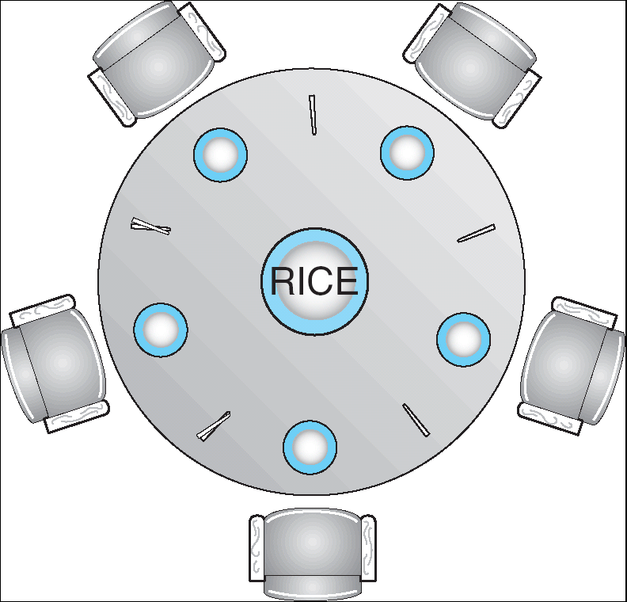
Dining-Philosophers Problem
The Dining Philosophers problem shows how improper resource allocation can cause deadlock when multiple processes compete for limited resources.

Slide 18
Contd…
The structure of Philosopher i:
While (true) {
wait ( chopstick[i] );
wait ( chopStick[ (i + 1) % 5] );
// eat
signal ( chopstick[i] );
signal (chopstick[ (i + 1) % 5] );
// think
}

Slide 19
Problems with Semaphores
Incorrect use of semaphore operations:
signal (mutex) …. wait (mutex)
wait (mutex) … wait (mutex)
Omitting of wait (mutex) or signal (mutex) (or both

Slide 20
Programming Language (OO) Solutions Monitors
A high-level abstraction that provides a convenient and effective mechanism for process synchronization
Abstract data type, internal variables only accessible by code within the procedure
Only one process may be active within the monitor at a time
But not powerful enough to model some synchronization schemes
monitor monitor-name {
// shared variable declarations
procedure P1 (…) { …. }
procedure Pn (…) {……}
Initialization code (…) { … }
}

Slide 21
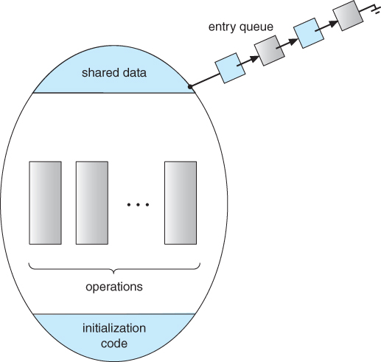
View of a Monitor

Slide 22
Condition Variables
condition x, y;
Two operations on a condition variable:
x.wait () – a process that invokes the operation is suspended until x.signal ()
x.signal () – resumes one of processes (if any) that invoked x.wait ()
If no x.wait () on the variable, then it has no effect on the variable

Slide 23
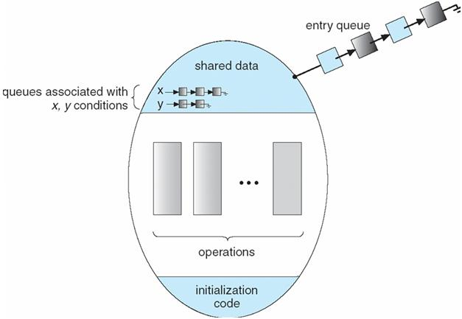
Monitor with Condition Variables

Slide 24
If process P invokes x.signal (), with Q in x.wait () state, what should happen next?
If Q is resumed, then P must wait
Options include
Signal and wait – P waits until Q leaves monitor or waits for another condition
Signal and continue – Q waits until P leaves the monitor or waits for another condition
Both have pros and cons – language implementer can decide
Monitors implemented in Concurrent Pascal compromise
P executing signal immediately leaves the monitor, Q is resume

Slide 25
Threads
A thread is the smallest unit of execution inside a process.
A process = a program in execution
A thread = a part of that program that runs independently
Threads allow a program to do multiple tasks at the same time

Slide 26
Key Characteristics
1. Threads share resources
Same memory (code, data, files)
2. Each thread has its own:
Program counter (what to execute next)
Registers
Stack (function calls)

Slide 27
Threads create concurrency, not always true parallelism
On single CPU:
Threads take turns (fast switching)
On multi-core CPU:
Threads can run truly in parallel

Slide 28
Types of Threads
User-level threads
Managed by user program
Kernel-level threads
Managed by operating system

Slide 29
#include <stdio.h>
#include <pthread.h>
int arr[] = {1, 2, 3, 4, 5, 6, 7, 8, 9, 10};
int even_sum = 0, odd_sum = 0;
// Thread to calculate even sum
void* evenSum(void* arg) {
for(int i = 0; i < 10; i++) {
if(arr[i] % 2 == 0) {
even_sum += arr[i];
}
}
printf("Even sum = %d\n", even_sum);
return NULL;
}
// Thread to calculate odd sum
void* oddSum(void* arg) {
for(int i = 0; i < 10; i++) {
if(arr[i] % 2 != 0) {
odd_sum += arr[i];
}
}
printf("Odd sum = %d\n", odd_sum);
return NULL;}
int main() {
pthread_t t1, t2;
pthread_create(&t1, NULL, evenSum, NULL);
pthread_create(&t2, NULL, oddSum, NULL);
pthread_join(t1, NULL);
pthread_join(t2, NULL);
printf("Main thread finished\n");
return 0;
}

Slide 30
Threads
Producer–Consumer problem, the producer and consumer work simultaneously.
To make two tasks run simultaneously inside one program, we use threads.
A thread is a lightweight unit of execution that allows multiple tasks to run concurrently inside the same program.
pthread_t p, c; pthread_create(&p, NULL, producer, NULL); pthread_create(&c, NULL, consumer, NULL);

Slide 31
Threads allow the producer and consumer to run simultaneously inside the same program, which is necessary to correctly model the Producer–Consumer problem.

